Slide 1
BATTERY MANAGEMENT SYSTEM FOR LOW EARTH ORBIT SATELLITES….
STUDENT NAME : M OSAMA NUSRAT
ADVISOR: SIR HABEEL AHMAD CO ADVISOR: DR MANSOOR ASIF

Slide 2
Project Timeline
Design Expo, Design and development
Hardware implementation
Nov-Dec
Jan-Feb
March-April
May
June
Proposal Defense
and Literature Survey
Mid-Defense, Testing and simulation
Report, Final defense, Open House

Slide 3
PROBLEM STATEMENT
Battery power management is a critical area for satellite systems
Algorithms are being developed to ensure maximum life of battery's installed on satellites
This project aims to develop a cost effective and simple battery management system for LEO satellites

Slide 4
WHAT IS A BMS
A Battery Management System (BMS) is an intelligent component of a battery pack responsible for advanced monitoring and management.
It is the brain behind the battery and plays a critical role in its levels of safety, performance, charge rates, and longevity

Slide 5
WHY DO WE NEED BMS
To prevent battery failure and mitigate potential hazardous situations, there is a need for a supervising system that ensures that batteries function properly in the final application.

Slide 6
BMS TOPOLOGIES
There are 3 types of BMS topologies.
Centralized
Distributed
Modular

Slide 7
Centralized Topology
In this topology a centralized master control unit is connected to each cell of battery pack. The controller unit protects and balances all the cells.
Advantage & Disadvantage:
It reduces the hardware but excess heat can be generated because controller is only source for cell balancing.
In addition cells are distributed between various locations of the satellite which requires a lot of wiring

Slide 8
Modular Topology
In this topology multiple slave BMS controllers are used to fetch the data and forward it to master controller so no special PCB is necessary to connect individual cell.
Disadvantage:
Isolated master slave communication is difficult.

Slide 9
Distributed Topology
In this topology there are small voltage & discharge monitor sockets which communicate with master controller of BMS.
Advantage & Disadvantage:
It is simple and reliable but it requires large no of small PCB’s and become difficult to mount on every type of cell.
I have used distributed topology in my project.

Slide 10
LEO SATELLITES
A low earth orbit (LEO) is generally defined as an orbit below an altitude of approximately 2000 km
Majority of artificial satellites are placed in LEO
Examples include paging, mobile, earth resource management etc.

Slide 11
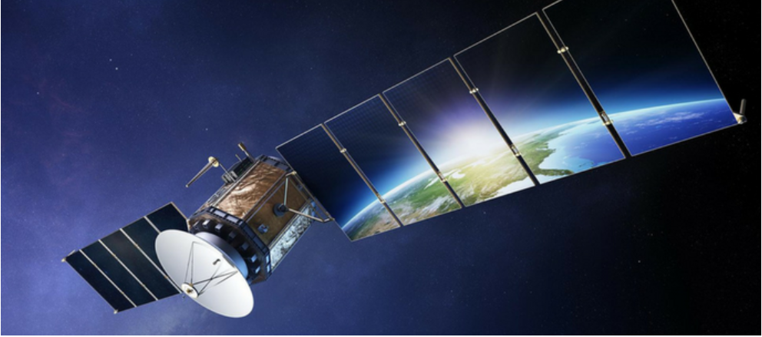
LEO SATELLITE WITH SOLAR PANELS FULLY EXTENDED

Slide 12
Power Generation in Leo Satellites
Satellites in space require Electric Power Generation. There is an Electrical Power System (EPS) Module that provide electrical power to all the modules of the satellite.
The only available source of this power is Solar Radiation
Photovoltaic (PV) Arrays collect solar power when they are exposed to solar radiations
Electrical Power System Module provides Maximum Power Point Tracking (MPPT) for extracting maximum power from these PV Arrays
In orbit, the satellite regularly passes through the shadow of the Earth. There, the radiations caught by the photovoltaic cells are not sufficient to generate enough electrical power. During this time, power is to be provided by battery bank instead.

Slide 13
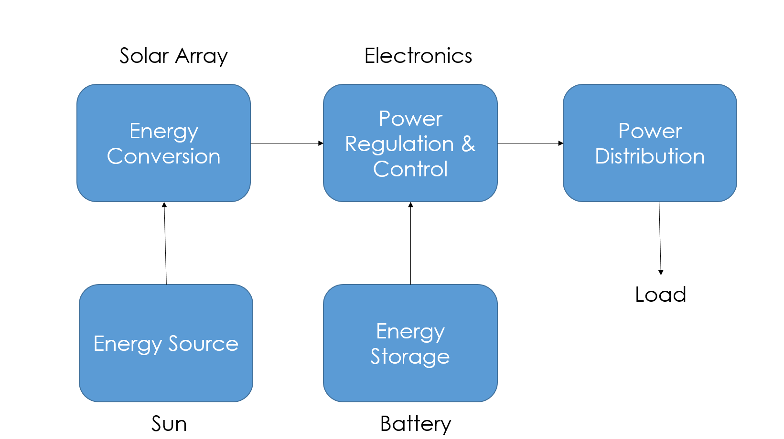
Power Generation in Leo Satellites Contd
The EPS thus needs batteries to store enough energy for the eclipses and peak demands.
Battery Charging and Management is also a major part of EPS Module.

Slide 14
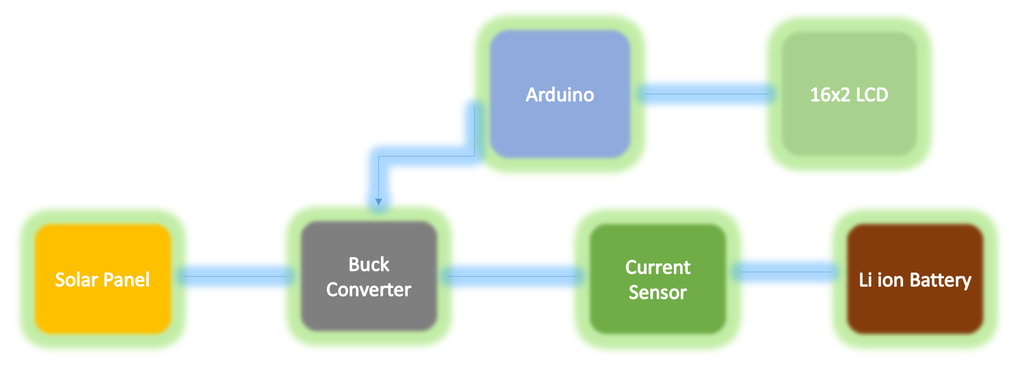
POWER REGULATION AND CONTROL

Slide 15
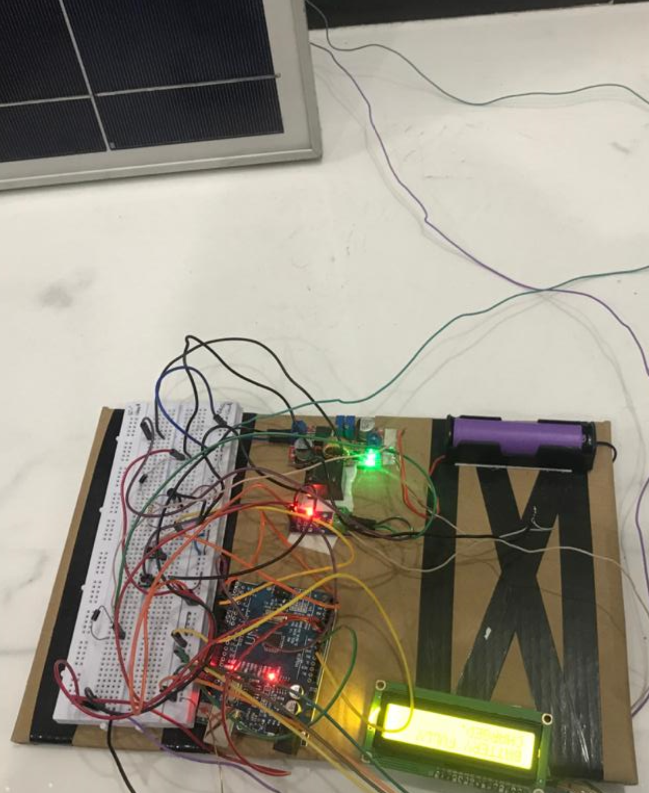
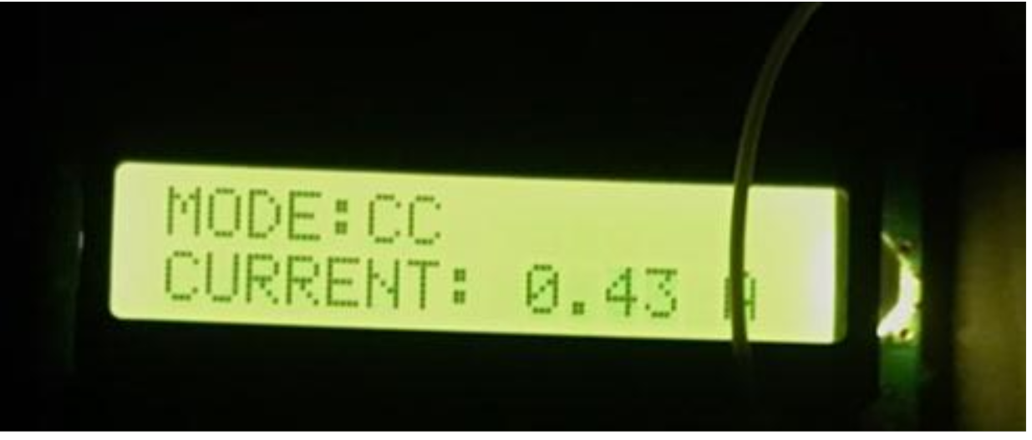
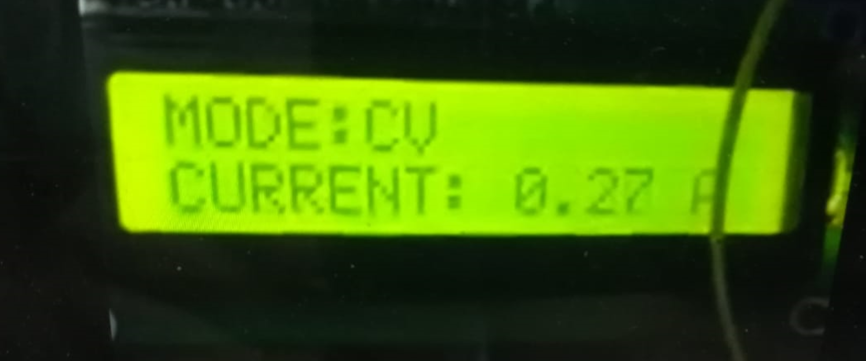
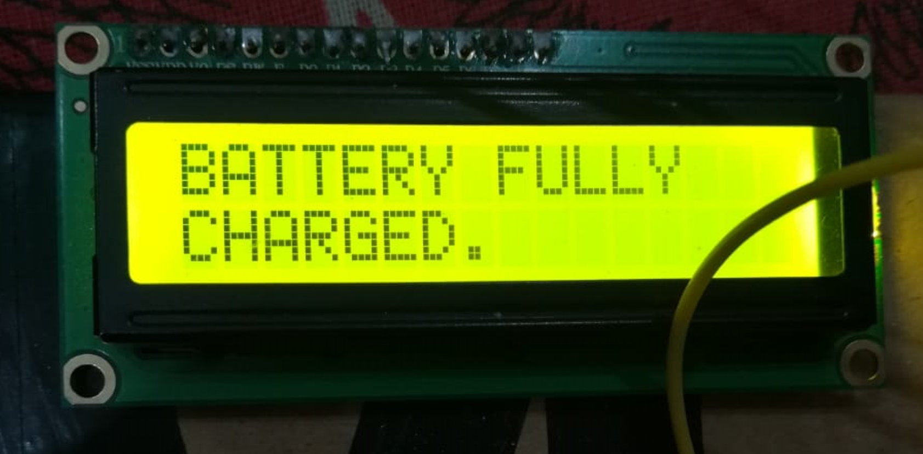

Slide 16
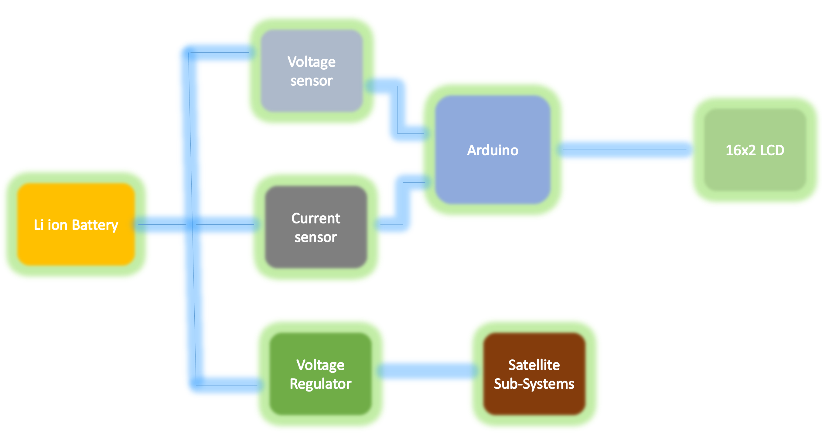
POWER DISTRIBUTION

Slide 17
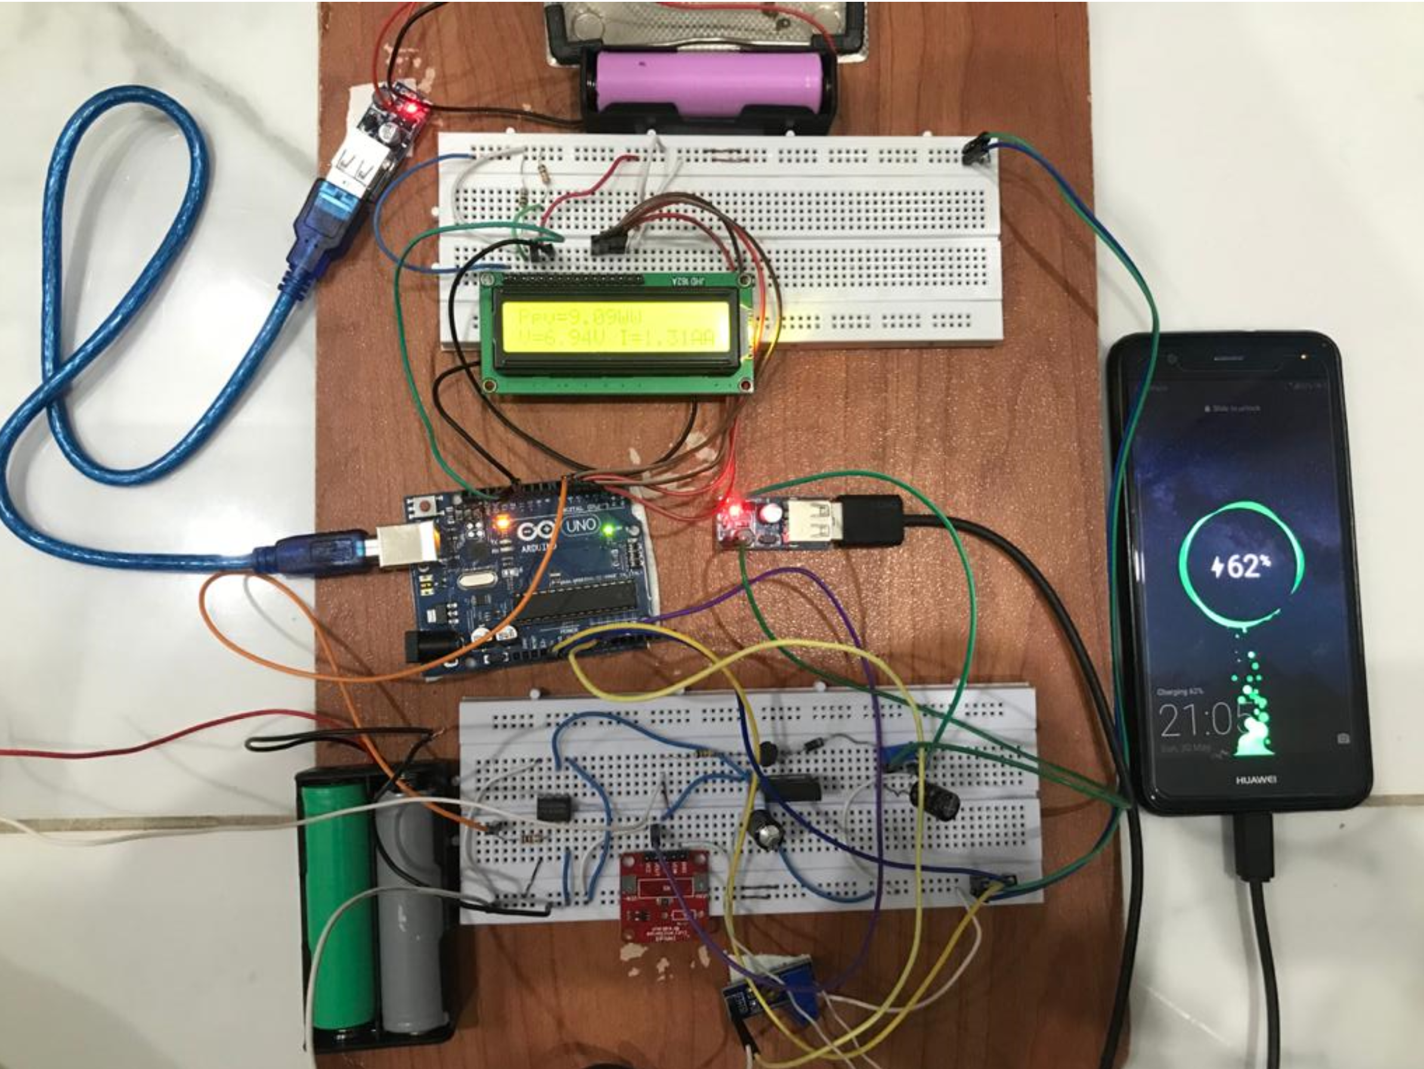
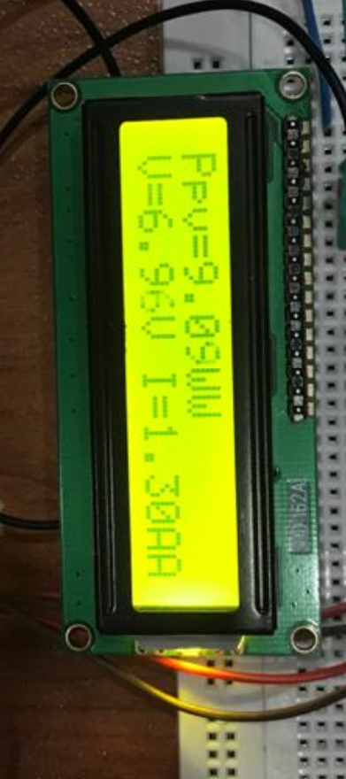

Slide 18
Charge Discharge Control
Controlling the process of charge and discharge of satellite’s batteries is one of the most critical process in EPS
I have used Buck converter to step down and regulate the voltage to charge the battery, and Boost converter to step up and regulate the output voltage from the battery to supply the loads(Satellite Sub-systems)

Slide 19
SOLAR CELL
A solar cell (also known as a photovoltaic cell or PV cell) is defined as an electrical device that converts light energy into electrical energy through the photovoltaic effect.
Solar cells are a form of photoelectric cell, defined as a device whose electrical characteristics – such as current voltage, or resistance vary when exposed to light.

Slide 20
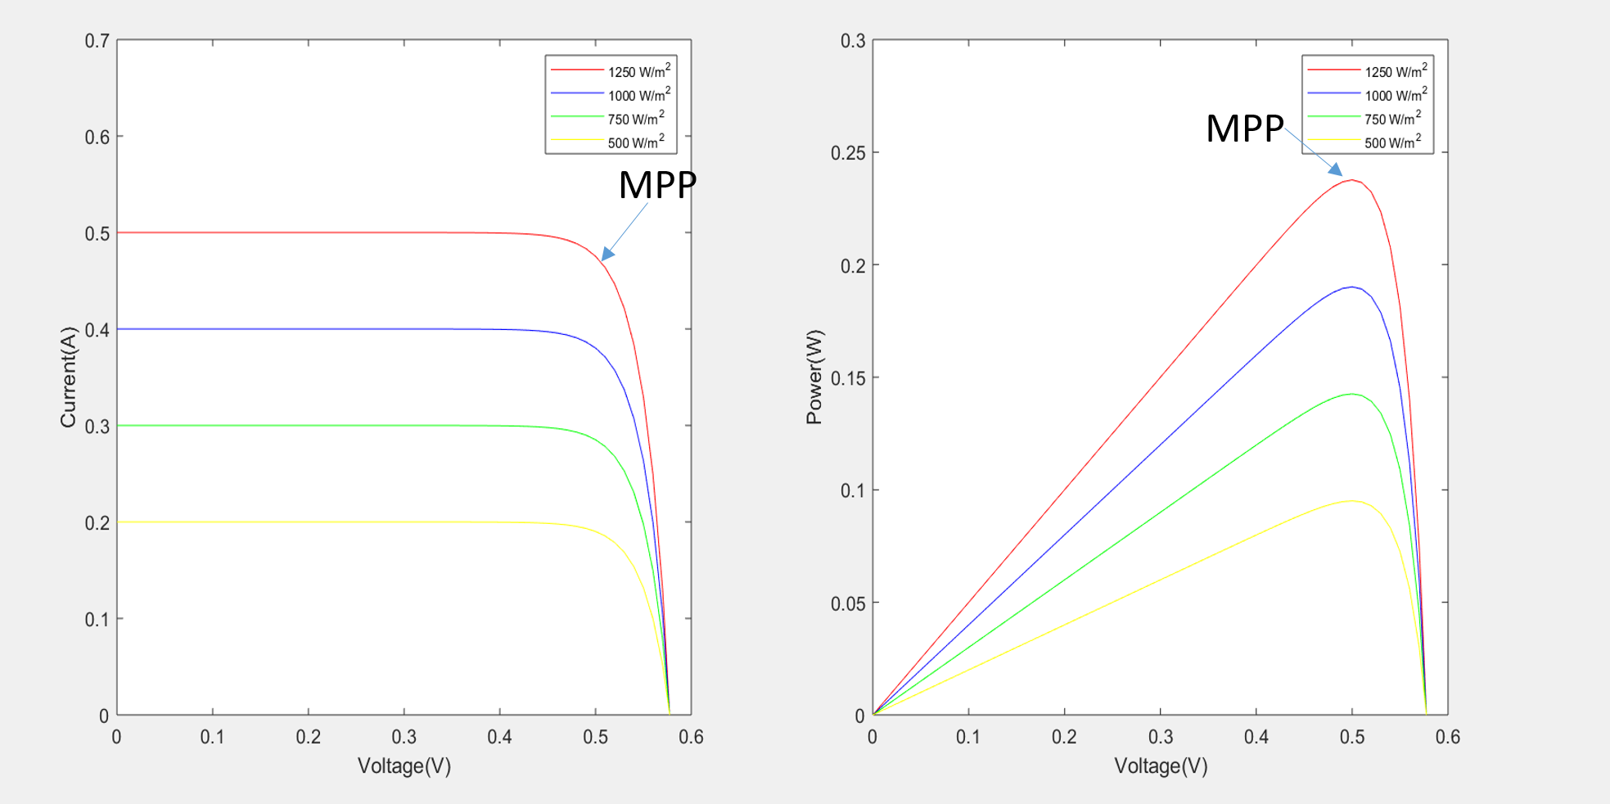
PV and IV characteristics of Solar Cell

Slide 21
MAXIMUM POWER POINT TRACKING
One of important factors to maximize the utilization and efficiency of any Photo-Voltaic (PV) system is the Maximum Power Point Tracking technique (MPPT).
MPPT is specifically used to extract the maximum available power from the PV array.

Slide 22
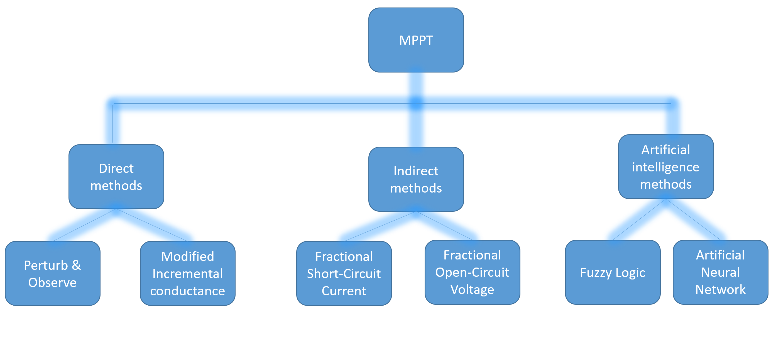
MPPT ALGORITHMS

Slide 23
DIRECT METHOD
Maximum power can be achieved by tracking the Maximum Power Point (MPP) using specialized algorithms such as Perturb and Observe (P&O) and Incremental Conductance (INC), Modified INC algorithm
After testing all the algorithms I came to a conclusion that modified INC is the most efficient algorithm, so I have used modified INC algorithm

Slide 24
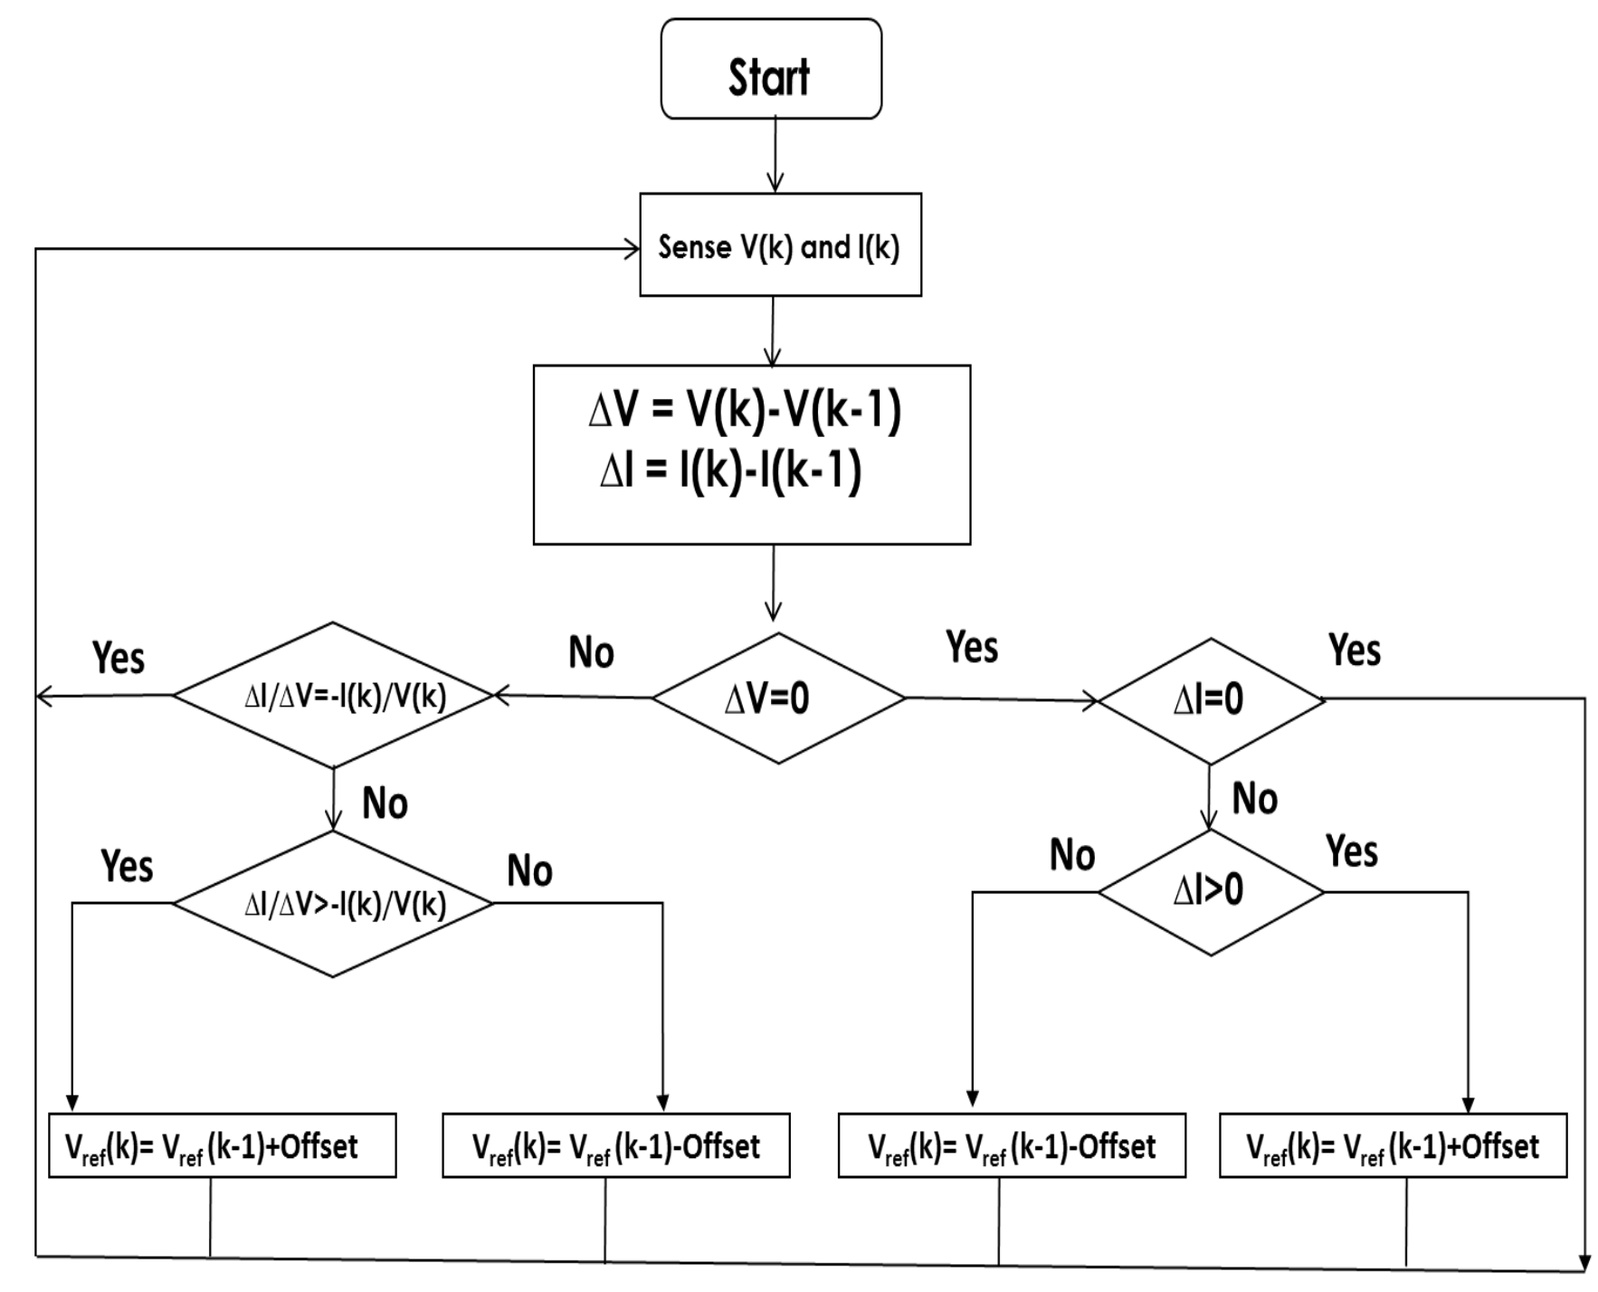
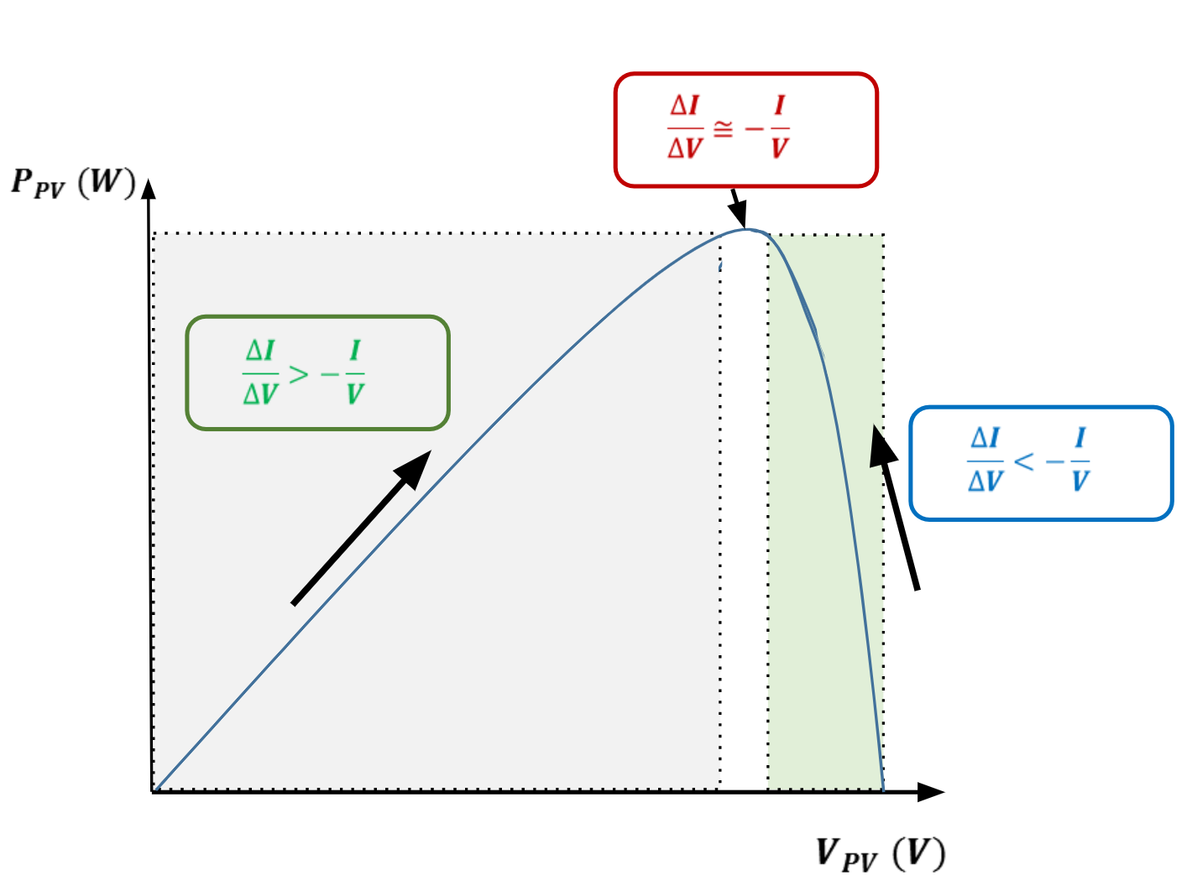
MODIFIED INCREMENTAL CONDUCTANCE ALGORITHM

Slide 25
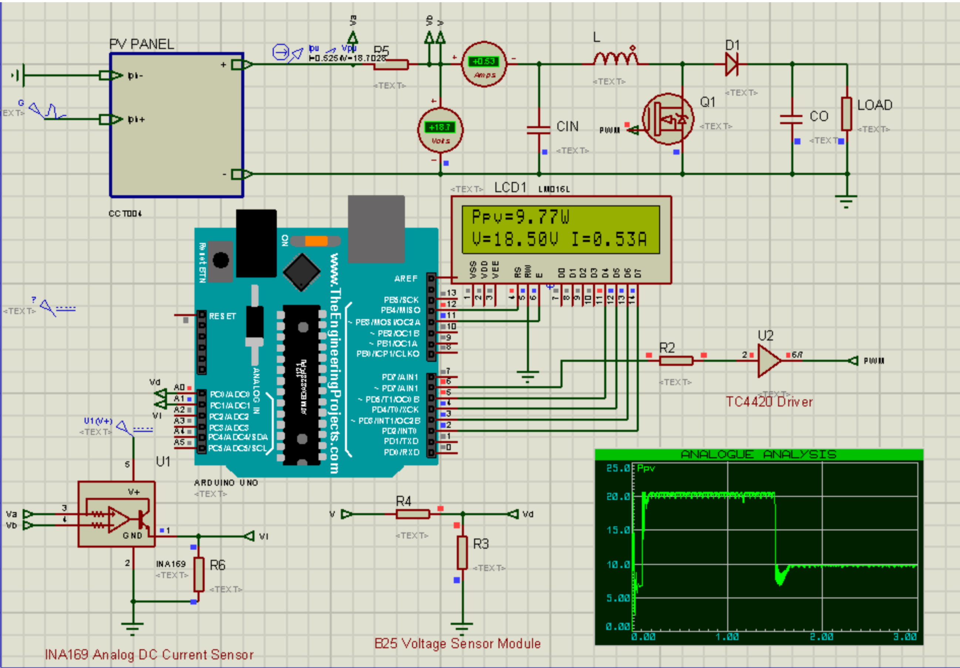
MPPT WITH MOD INC ALGORITHM PROTEUS SIMULATION

Slide 26
BATTERIES AS SECONDARY SOURCE
Most Satellites which use Solar Array as the main power source, need a secondary power source; e.g. rechargeable batteries, to be used in time of shadow
At sunlight time, the power will be harvested from the solar-PV arrays to supply the loads and charge the batteries through the main bus.
During the eclipse, the battery will be the main power source and it will supply the loads through the bus.
Many kind of rechargeable batteries can be used in space such as Nickel Hydrogen, Nickel Cadmium and Lithium Ion.

Slide 27
Lithium Ion Battery
I have used Lithium Ion battery as it has many advantages than the other types of batteries such as high energy density, high power density, low self-discharge,, long lifespan, and wide temperature range.
Controlled charge and discharge of a battery is required to maintain battery voltage within limits, to extract the best performance from the battery and to prolong the life time

Slide 28
Charging algorithm of Lithium-ion batteries
Constant current-constant voltage Algorithm
Among all charging algorithms, the constant current-constant voltage (CC/CV) charging algorithm is well developed and widely adopted in charging lithium-ion batteries because of its simplicity and easy implementation.
Under the arrangement of the CC/CV charging algorithm, a constant current is applied to charge the battery until the battery voltage rises to a preset maximum charging voltage
The charging voltage is held constant at V preset and correspondingly the charging current is reduced exponentially.
The charging process stops when charging current reaches a present small current.

Slide 29
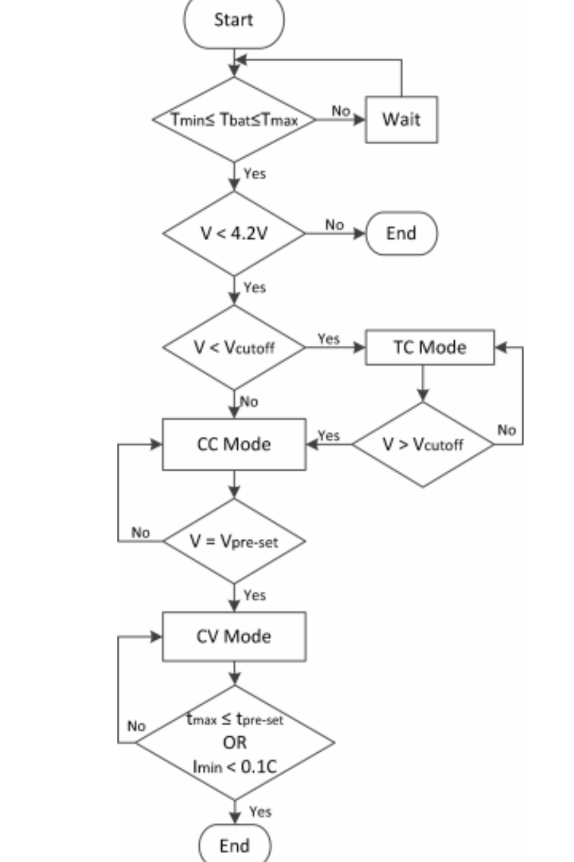
CC / CV FLOWCHART

Slide 30
BATTERY PROTECTION
Energy storage has become a fundamental component in renewable energy systems, especially those including batteries.
However, in charging and discharging processes, the battery’s user does not control some of the parameters.
That uncontrolled working leads to aging of the batteries and a reduction of their life cycle. Therefore, it causes an early replacement.
Development of control methods seeks battery protection and a longer life expectancy, thus the Constant-current–constant-voltage method is mostly used.

Slide 31
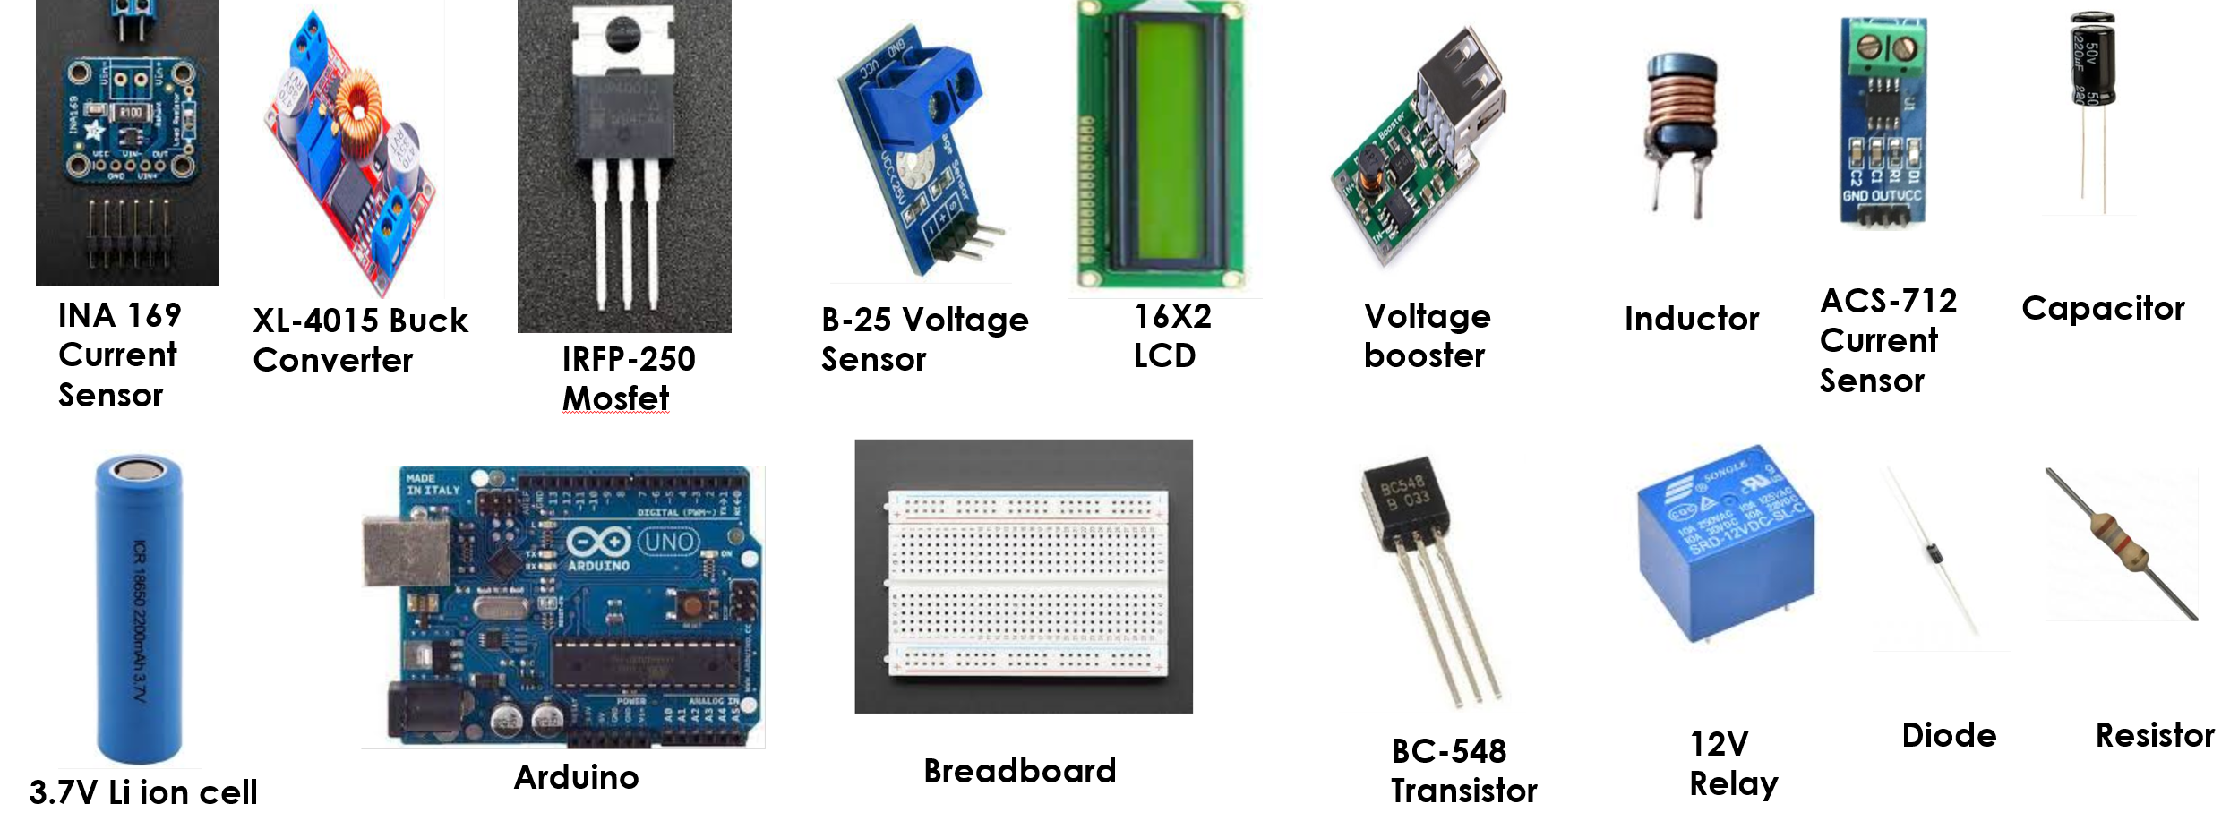
HARDWARE USED

Slide 32
CHALLENGES
Unavailability of INA-169 current sensor had to order it from amazon. The order came after 1month.
Faced calibration issue in XL-4015 buck converter in battery charging module. The issue was solved after 1 week.
Some components were burned during testing, I had to buy them again.
Due to closure of university it was difficult to focus and get motivated and work in home all alone.

Slide 33
FUTURE PROSPECTS
I have used lithium ion batteries to give power in case of eclipse to my satellites. A better and advanced approach is to use super capacitors. Super capacitors are more efficient.
A mock-up of LEO Satellite may be developed at SEECS for design and development of various satellite subsystem as it is an emerging area.
My work may be extended in terms of power generation and battery backup to Increase its capacity.
Use of AI in battery management system may be explored to enhance the battery life.

Slide 34
CONCLUSION
I have learned and applied many power electronics concepts.
I implemented Buck converter, Boost converter in Lt Spice.
I have implemented MPPT and its algorithms and I have also implemented a charge controller.
This project was a source of great learning for me.

